Slide 1
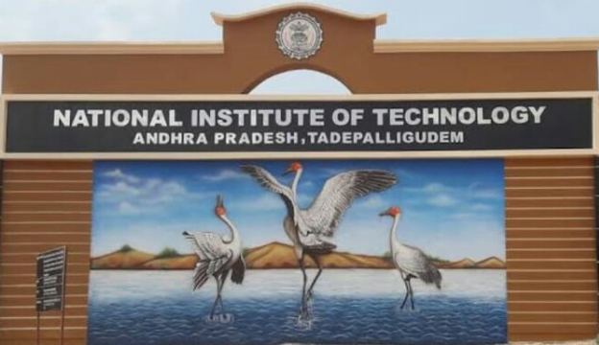

Slide 2
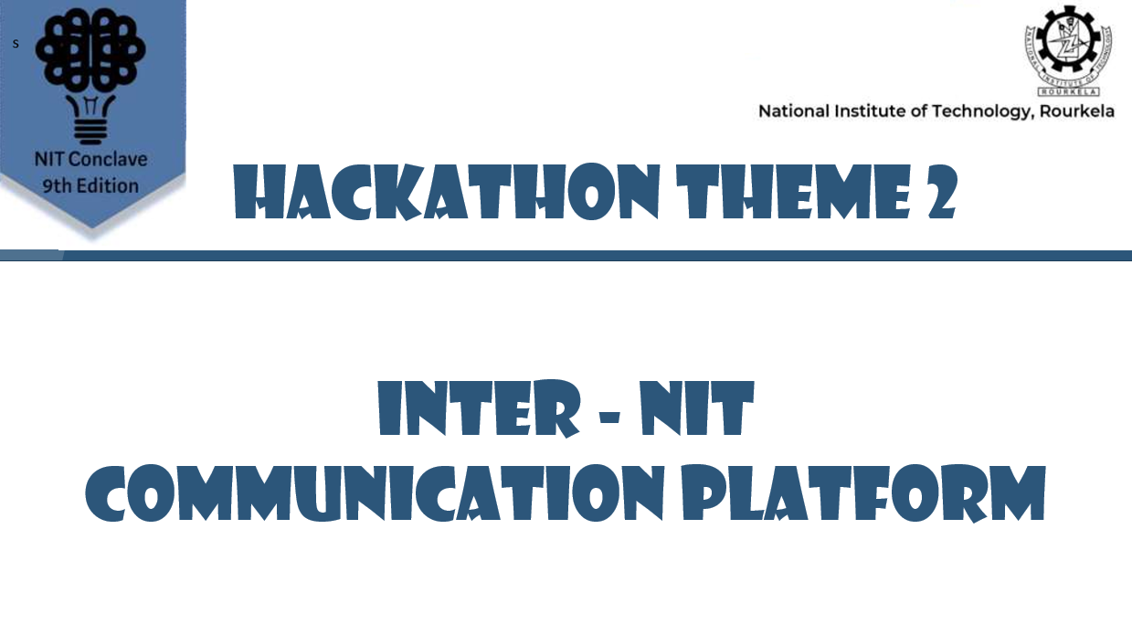

Slide 3



Case # 1
STUDENT OF NIT X

Slide 4
Less
Interested in project
Start Seeking
Less
Enthusiasm
For team
Good friend of him
NIT X
NIT X

Slide 5

Sacrifice
NIT X

Slide 6

Case # 2
NIT X

Slide 7

Highly interested
In project
Enthusiastic
Good team spirit
Unavailability of required lab equipments / devices

Slide 8
SACRIFICE AGAIN

Slide 9
What to do?

Slide 10
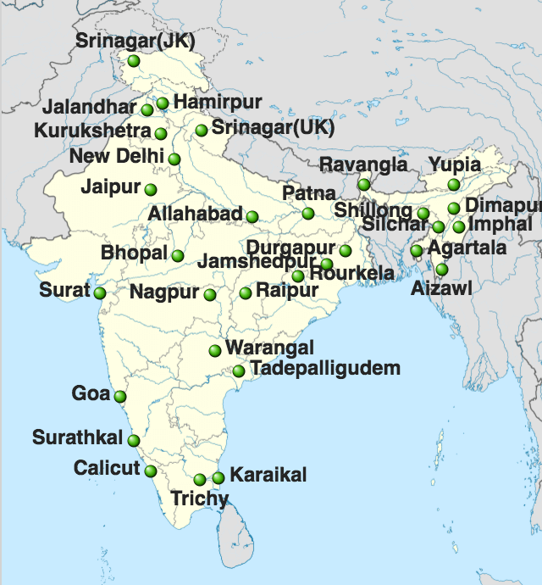
StuMaze
AN INTER - NIT Student networking and Team building platform

Slide 11
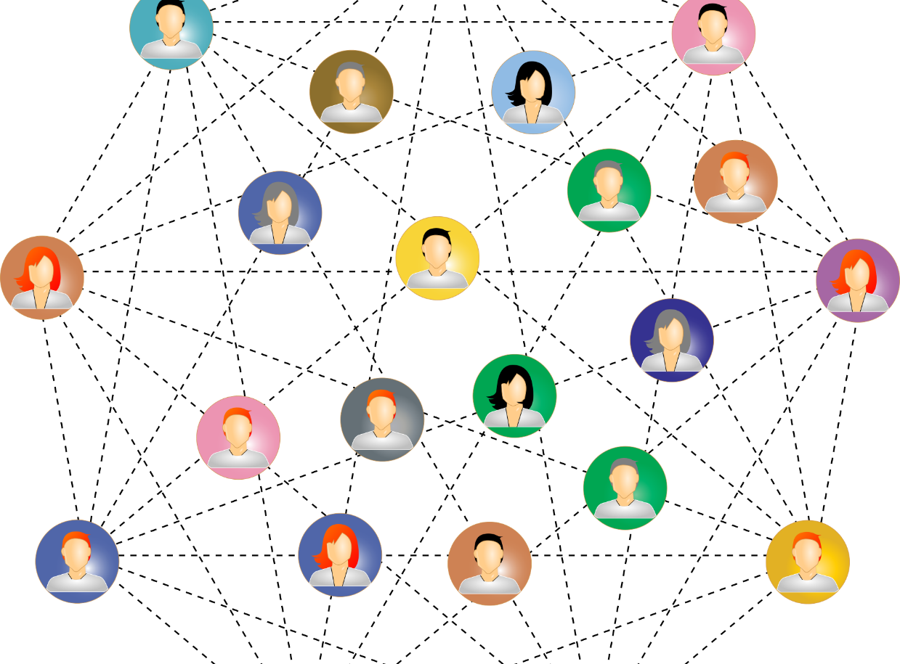


WHAT IS STUMAZE PLATFORM
StuMaze platform is designed as a one step platform which aim at the needs of NIT student to have social interlink between all NIT students all as well as faculties and this applications allows students for doing projects or startups with team building through StuMaze.
11

Slide 12

Why we are making this platform ?
Students don’t get the required team mates for their project work in their respective NITs according to their own field .
Unavailability of resources and lab equipment for their required project due to lack of funding.

Slide 13
Why we are making this platform ?
Huge communication gap between students of one NIT student to another NIT college student.
Lack of platform to connect NIT students to discuss innovative Ideas and work as a team and contribute in a project.

Slide 14





Features of the STUMAZE platform
Student Network
Laboratories
Projects
Study Material

Slide 15


Brief about features
Student network
Creation of a professional networking site to connect all NIT students from different backgrounds and colleges and also connecting them with each other so that they can get connected according to their skills, fields of education and projects done by them through our project and innovation lab feature.
All Students have their profile containing resume on platform which includes :
Personal details
Skills and projects they have worked upon
Education
Field Of Interest
15

Slide 16

Brief about features
Projects
Students can get the compatible team partner for their innovative projects and to get the better solutions of the problems by creating the vast network between NITs

Slide 17

Brief about features
Study material
Exchanging the digital content of study materials between NIT students which is accessible anytime and also improving their learning with the project tutorial recently published researches and other practical content related to their fields and also it will contain tutorials to the projects that are being completed in innovation labs paid as well as free.

Slide 18
Brief about features
Laboratories
Laboratories are a very crucial part of every NIT. The Stumaze platform may be useful for all the students to get access to other NIT laboratories. The application will have the database of all NIT laboratory devices and equipments so that all students can have access to the required tools for their researches and projects.

Slide 19
Interface of Stumaze

Slide 20


Slide 21
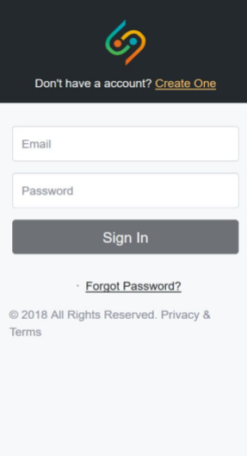

Slide 22
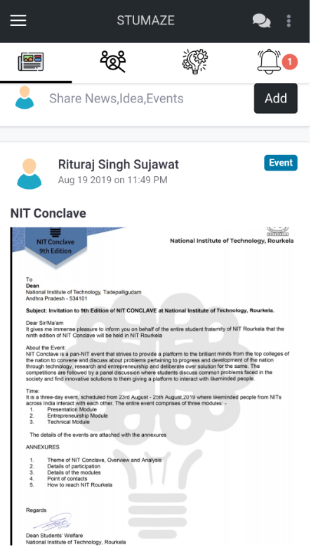

Slide 23
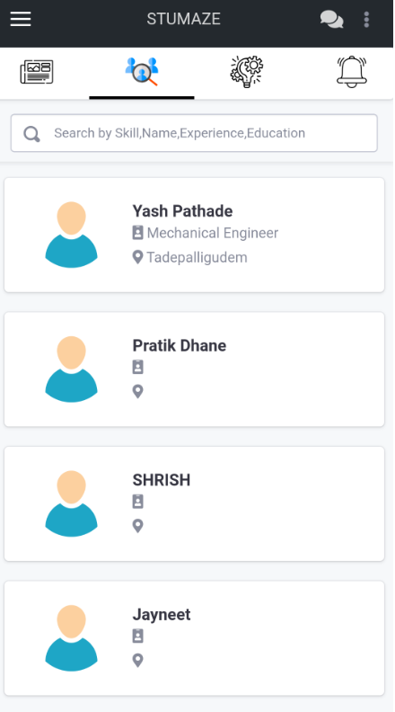

Slide 24
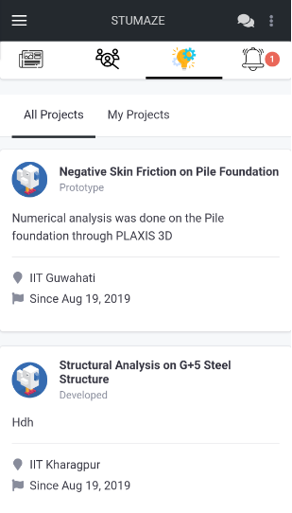

Slide 25
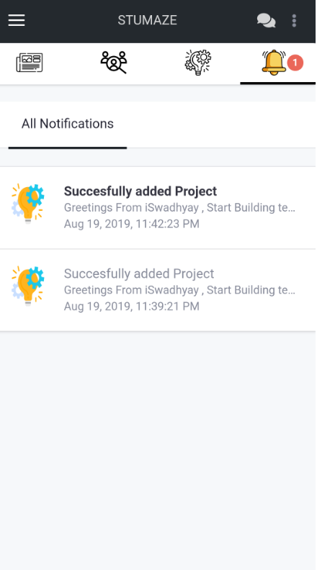

Slide 26
FUTURE SCOPES
Platform that can be used to conduct online quiz and other competitions to enhance the competitive spirits between Inter-NIT students.
The database available on Stumaze will be helpful to meet the demand of companies and corporations so that they can filter the candidates according to their skills.
A medium that can connect all NIT students to an important guest lecture over a single network.

Slide 27
It is the long history of humankind that those who learned to collaborate and improvise most effectively have prevailed." – Charles Darwin

Slide 28

Thank you
STUMAZE
-A Solution by
NIT ANDHRA PRADESH

